Slide 1
Continuous Time Systems
Signals and Communication Systems (SCS)
Session-7

Slide 2
Continuous Time Systems
Classification of Systems
Time domain Analysis of LTI systems
(Convolution Integral)
3. Properties of LTI systems

Slide 3
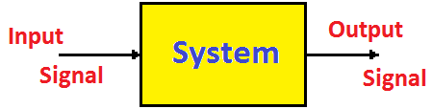
What is a ‘System’?
A System may be defined as a physical device that operates on a signal.
Examples:
PA System (Public Address System)
Digital Computer
Mobile Phone

Slide 4
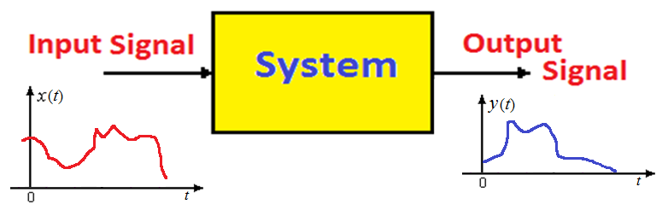
Relation between Signal and System
Signal: Physical quantity
System: Physical device
The input signal is modified according to the characteristics of the system and gives some output.

Slide 5

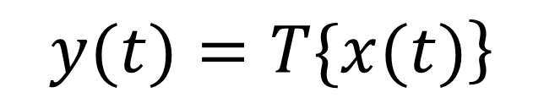
Representation of systems
$$\left.y(t)=T\{x(t)\right\}$$

Slide 6
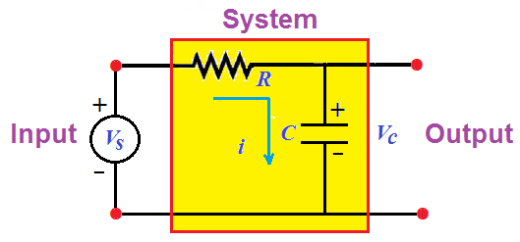

Examples

Slide 7
Classification of Systems

Slide 8
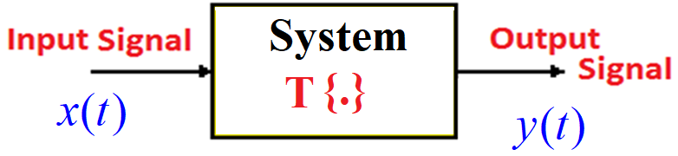











Input and Outputs of Systems

Slide 9







Understanding the meaning of input-output relation of a system

Slide 10
Systems with and without Memory (Static or dynamic systems)
A system is said to be memoryless or static if its output for at any instant of time ‘t‘ depends on the input at the same time but not on the past or future inputs.
Static or Memoryless
Dynamic or Memory
Static

Slide 11
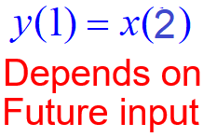
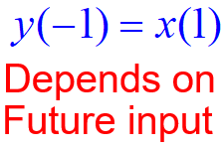
(Static or dynamic systems)
Dynamic
Dynamic
Static
Static
Dynamic
Dynamic

Slide 12
2. Causal versus Non-causal systems (Non-anticipative and anticipative)
A system is said to be causal, if the output at any time depends on values of the input at only the present and past times but does not depend on the future inputs.
Causal Systems are Real Time systems and Physically Realizable
Causal
Causal
Causal

Slide 13

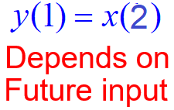


Causal versus Non-causal systems
Non-causal
Causal
Non-causal
Causal
Non-causal
Non-causal
Causal

Slide 14
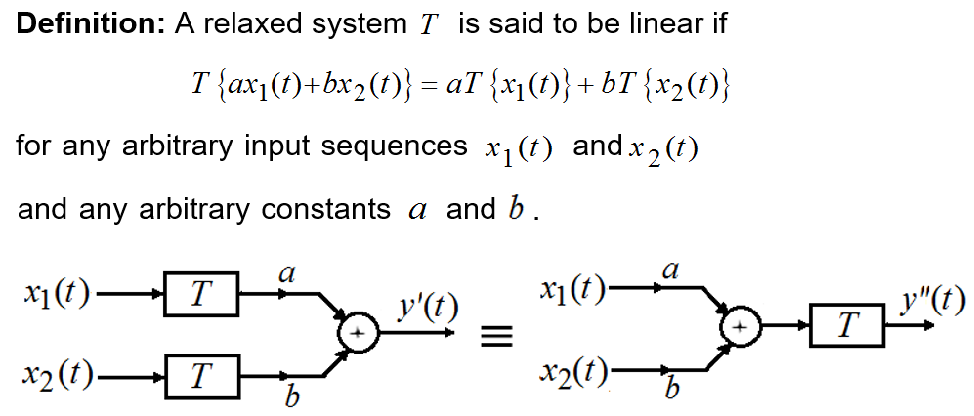
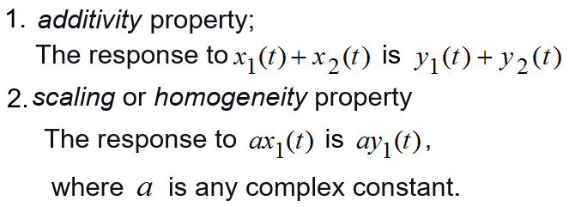
3. Linear versus nonlinear systems

Slide 15
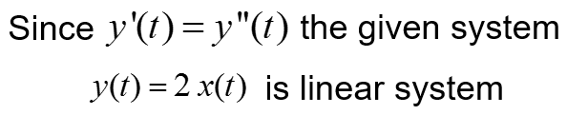
Test for linearity

Slide 16
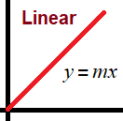
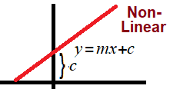
Linear versus nonlinear systems
Non-linear
Linear
Non-linear
Linear
Linear
Linear
Non-linear

Slide 17
Continuous Time Systems
Signals and Communication Systems (SCS)
Session-8

Slide 18

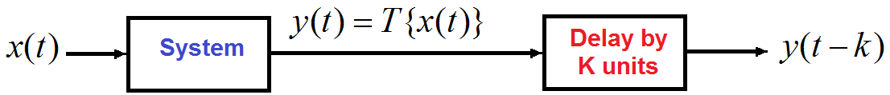

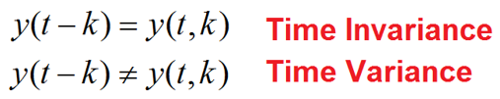
4. Time-Invariant versus Time Variant
A relaxed system T is said to be time invariant or shift invariant, if the system response does not change with time.
For every input x(t) and for every time shift ‘k’.

Slide 19
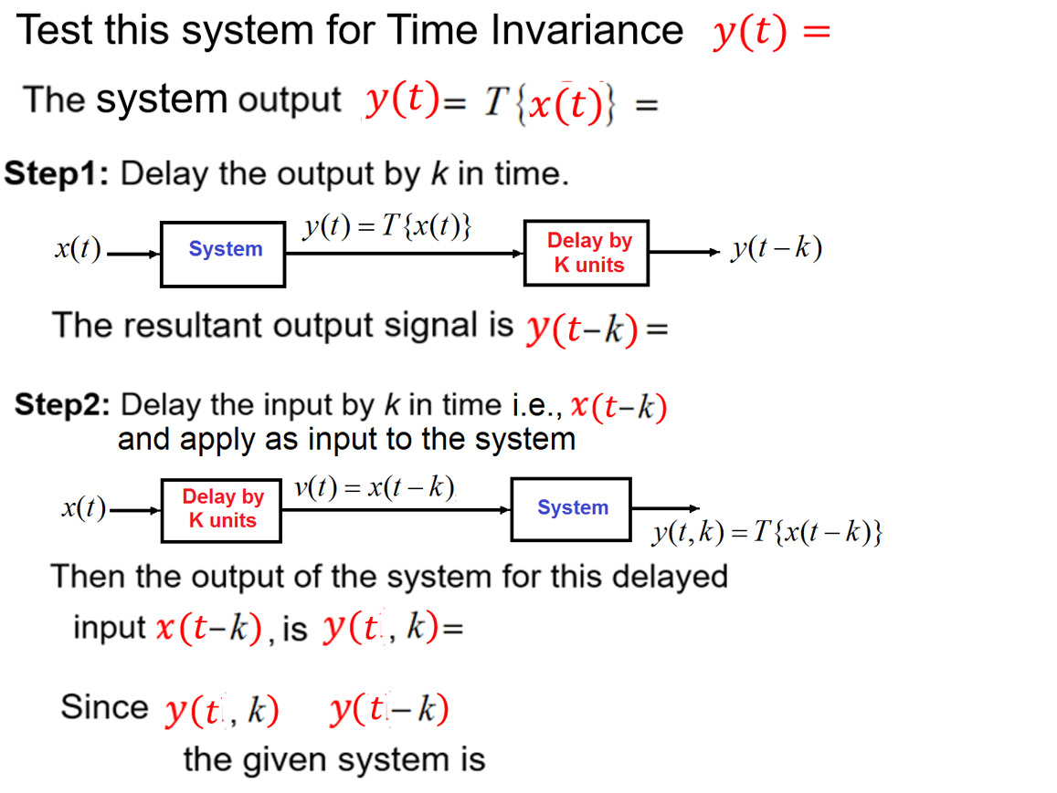

Slide 20
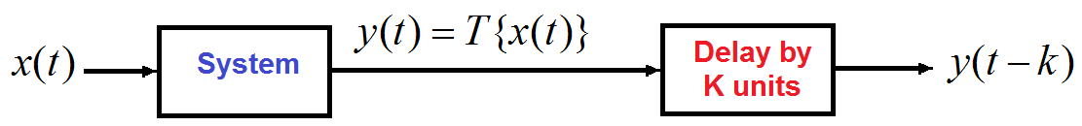
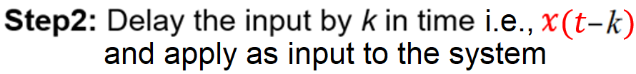
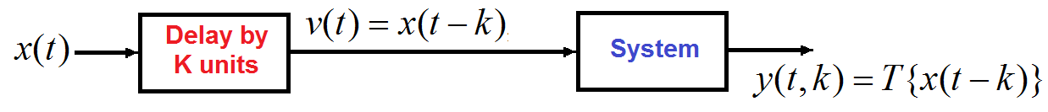
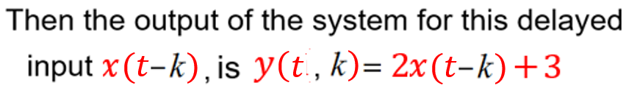
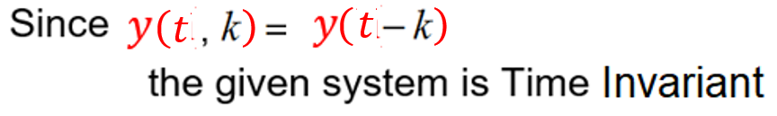
which is 2 times input plus 3

Slide 21
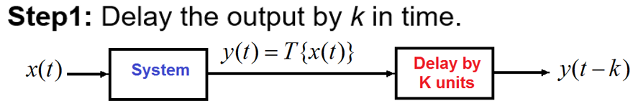
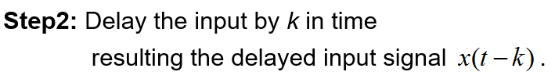

Test this system for Time Invariance

Slide 22



which is compressed the input by 2 times

Slide 23



which is time reversal of input and shift right by 2 units

Slide 25
Time-invariant versus time-variant systems
Time-invariant
Time-variant
Time-variant

Slide 26
5. Stable versus Unstable systems
A stable system is such that well-behaved outputs are obtained for well-behaved inputs.
A system is said to be bounded input bounded output (BIBO) stable, if and only if every bounded input results in a bounded output.

Slide 27





Slide 28




Slide 29
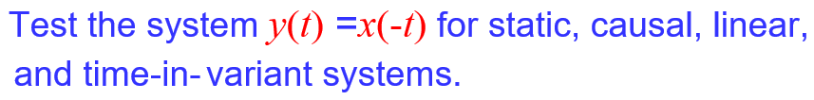









Slide 30







$$\left.\left.y\left.(\right.t)\right.=x\left.(\right.t−2)\right.$$

Slide 31
End

